Slide 1
ITU-T Sync Standards Update
February 2020
Tim Frost

Slide 2
ITU Sync Standards Categories
Transfer of frequency to meet 50ppb (2G/3G/4G FDD)
Using SyncE, or using PTP over existing networks
Transfer of time to meet 1.5μs (3G/4G TDD, LTE-A)
Using PTP over new networks with T-BC and SyncE at every node
Transfer of time to meet 1.5μs (3G/4G TDD, LTE-A)
Using PTP over existing networks
Transfer of time to meet 130ns (5G NR)
PTP over Fronthaul networks
Sync OAM (general)
ALMOST DONE!
ALMOST DONE!

Slide 3
ITU-T Packet Sync Recommendations
Definitions / Terminology
G.8260: Definitions and Terminology for Synchronization in Packet Networks (includes PDV metrics)
Frequency to 50ppb
Time and Phase to 1.5µs
Enhanced Time for 5G
Basic Aspects
G.8261: Timing and Synchronization Aspects in Packet Networks (Frequency)
G.8271: Time and Phase Synchronization Aspects in Packet Networks
Network Requirements
G.8261.1: PDV Network Limits (Frequency)
G.8271.1: Network Limits for Time/Phase (Full Timing Support)
End applications requiring ±1.5µs End applications requiring 130/260ns relative time error
G.8271.2: PDV Network Limits (Partial Timing Support)
G.8261: Enhanced Network Limits for Frequency
G.8262: Ethernet Equipment Clock (EEC) Specification
G.8262.1: Enhanced EEC Specification
G.811.1: Enhanced PRC Specification
G.8263: PTP Slave Clock Specification (Frequency)
G.8272: PRTC Specification – Class A PRTC Specification – Class B
Clock Specifications
G.8272.1: Enhanced PRTC Specification
G.8266: Grandmaster Clock Specification
(Frequency)
G.8273: Time/Phase Clocks Framework
G.8273.1: T-GM Specification
G.8273.2: T-BC & T-TSC Specifications – Class A, B T-BC & T-TSC Specifications – Class C, D
G.8273.3: T-TC Specification – Class A, B
G.8273.4: APTS and PTS Clock Specifications
Methods and Architecture
G.8264: Distribution of Timing Information (ESMC)
G.8275: Architecture for Packet-Based Time/Phase Delivery Coherent network PRTC (cnPRTC)
FTS, APTS and PTS architectures Fronthaul synchronization architectures, FlexE/OTN
G.8265: Architecture for Packet-Based Freq. Delivery
Profiles
G.8265.1: PTP Telecom Profile for Frequency
G.8275.1: PTP Profile for Time (Full Timing Support)
G.8275.2: PTP Profile for Time (Partial Timing Spt)
Published
Approved
Under development
Not active

Slide 4
What’s new?

Slide 5
Recommendations approved in Feb. 2020 (to be published by end of March 2020)
Main new performance spec. at Feb.’20 meeting
Clock specifications:
G.8273.4 – APTS and PTS clock specification
G.8262 Amd. 1 – Adds PAM4 (50G, 100G, 200G) interfaces to the list of SyncE-capable interfaces
G.8272 Rev. – Scope change to remove restrictions on PRTC-B deployment
G.8273.2 Amd. 1 – Mostly editorial changes
Network limit specifications:
G.8261 Amd. 1 – Adds the TDEV network limit for a chain of enhanced clocks (e.g. eEECs)
G.8271.1 Rev. – Adds discussion on how to estimate relative TE from existing measurements
PTP Profile updates:
G.8275.1 Rev. – Adds reference to IEEE1588-2019 (PTP version 2.1)
G.8275.2 Rev. – Guidance on clockAccuracy values for enhanced PRTCs in holdover
General Information:
G.8260 Rev. – Guidelines on relative TE measurement
G.8271 Rev. – Information on inter-operator sync requirements for 5G NR
G.8273 Rev. – Appendix on least-squares filtering for noise transfer testing
G.Sup.SyncOAM – Informative supplement detailing what OAM parameters clocks should support
GNSS Tech. Rep. – Informative document on using GNSS for timing
New development, see next slide

Slide 6
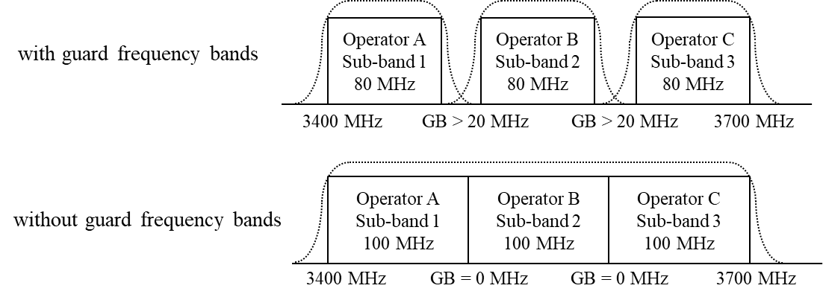
Inter-operator synchronization
At 5G, operators want to remove frequency guard bands to gain spectrum:
To avoid interference, all operators must synchronize to the same reference (e.g. UTC)
Currently there is a “gentleman’s agreement” between Japanese operators to all synchronize to within 1.5µs of UTC
European operators are also raising the topic
New Appendix VI in G.8271 discusses the issue
Expect this to start to become a regulatory requirement for 5G TDD operators
This will therefore require ongoing testing and validation, particularly field test
May even lead to spectrum sharing in some cases

Slide 7
Enhanced Clocks and Network Limits

Slide 8
Enhanced Clock Specifications for 5G
Network Limits
G.8261, G.8271.1
As low as ±100ns
Classes C, D T-BC, G.8273.2
±5ns Max. Time Error (D)
Classes C, D T-TSC G.8273.2
±5ns Max. Time Error (D)
GNSS
T-TSC
T-BC
T-BC
T-BC
Class B PRTC, G.8272, ±40ns
ePRTC, G.8272.1, ±30ns
End clock
(e.g. eNodeB)
ePRC, G.811.1
±1E-12 FFO
eEEC, G.8262.1
Wander Gen: 7ns MTIE, 0.64ns TDEV

Slide 9
Enhanced Specifications for 5G
Enhanced specifications agreed:
G.811.1 ePRC – published August 2017
G.8272.1 ePRTC – published August 2017
G.8272: PRTC Class B – published January 2019
G.8262.1: eEEC – published January 2019
G.8273.2: Class C and Class D T-BC and T-TSC – published January 2019
G.8261: Network Limit for chain of eEECs
Network limit much lower, to permit better SyncE-assisted holdover of T-BCs and T-TSCs
Status: agreed, to be published by end 2019
G.8271.1: Network Limit for chain of T-BCs
New budget to meet 1.5µs using Class C clocks, even under long outages (2-3 days)
New network limit based on Class C, D T-BC specification, targeting around ±130ns end-to-end
New network limit for relative time error, targeting fronthaul clusters
Status: proving more difficult than expected Expected completion now 2021

Slide 10
Fronthaul networks – what’s the issue?
Up to now, it has commonly been thought that the relative TE requirements (130 or 260ns TAE) is the biggest problem
New issue emerging is frequency accuracy to meet 50ppb
Problem is that the Radio Units cannot provide the low-pass filtering that previous NodeB or eNodeB’s provided
Small cheap devices, with much worse thermal environments
Old network limits meet the 50ppb requirements over the long term, but not the short term
Even chains of Class C clocks look to have too much short term wander
Frequency network limits currently under discussion between ITU-T and ORAN
ORAN want around 15ppb from the network, with 75mHz filtering
Acceptable solution is not readily apparent at present (Feb. 2020)

Slide 11
Frequency network limit
G.8261.1 Frequency Network Limit
> 50 ppb
< 16 ppb
Low-pass filtering required
< 50 ppb
360

Slide 12
G.8272: Comparing PRTC Classes
Parameter | Conditions | Class A | Class B | ePRTC (G.8272.1)
Max|TE_{L}| | 1pps: unfiltered PTP: 100-sample moving average low-pass filter | 100ns | 40ns | 30ns
dTE_{L} MTIE | 1pps: unfiltered PTP: 100-sample moving average low-pass filter | 100ns (max) | 40ns (max) | 30ns (max)
dTE_{L} TDEV | 1pps: unfiltered PTP: 100-sample moving average low-pass filter | 3ns up to 100s, rising to 30ns @ 1000s | 1ns up to 100s, rising to 5ns @ 500s | 1ns up to 30Ks, rising to 10ns @ 300Ks
ePRTC has very long-term holdover, requiring high-performance Caesium oscillator
PRTC-B intended for distributed applications where an ePRTC would not be practical
Expected to be based on multi-band GNSS receivers to compensate for the ionosphere
Holdover provided by SyncE rather than a Cs oscillator

Slide 13
SyncE: Comparing G.8262 to G.8262.1
Parameter | EEC (G.8262) | eEEC (G.8262.1)
Frequency Accuracy | 4.6ppm | Same value
Pull-in/Hold-in | 4.6ppm | Same value
Wander generation | MTIE: 40ns @ 0.1s, rising to 113ns @1000s TDEV: 3.2ns @ 0.1s, rising to 6.4ns @1000s | MTIE: 7ns @ 0.1s, rising to 25ns @1000s TDEV: 0.64ns @ 0.1s, rising to 1.28 ns @1000s
Wander tolerance | 250ns @ 0.1s, rising to 5000ns @ 1000s | Same value (allows mixed chains)
Jitter generation | 0.5UI (1G, 10G) 1.2UI (25G lanes) | Same value (1G) 10G, 25G: for further study
Jitter tolerance | 250ns @ 10Hz, reducing to 1.5UI (3.6UI for 25G lanes) | Same value (1G) 10G, 25G: for further study
Clock Bandwidth | 1 – 10Hz | 1 – 3Hz
Transient response | 120ns initial step, then 50ns/s (const. temp) | 10ns initial step, then 10 ns/s (const. temp)
Holdover | 120ns initial step, then 50ns/s frequency offset, plus 1.16 x 10⁻⁴ ns/s² drift (const. temp) | 10ns initial step, then 10 ns/s frequency offset, plus 1.16 x 10⁻⁴ ns/s² drift (const. temp)
Key: Green – same as G.8262 EEC spec
Red – changes to G.8262 EEC spec

Slide 14
G.8273.2: Comparing T-BC Classes
Parameter | Conditions | Class A | Class B | Class C | Class D
Max|TE| | Unfiltered, 1000s | 100ns | 70ns | 30ns | FFS
Max|TE_{L}| | 0.1Hz low-pass filter, 1000s measurement | - | - | - | 5ns
cTE | Averaged over 1000s | 50ns | 20ns | 10ns | FFS
dTE_{L} MTIE | 0.1Hz low-pass filter Const. temp, 1000s | 40ns | 40ns | 10ns | FFS
 | 0.1Hz low-pass filter Var. temp, 10000s | 40ns | 40ns | FFS | FFS
dTE_{L} TDEV | 0.1Hz low-pass filter Const. temp, 1000s | 4ns | 4ns | 2ns | FFS
dTE_{H} | 0.1Hz high-pass filter Const. temp, 1000s | 70ns | 70ns | FFS | FFS
Class C aimed at shorter chains (up to 10 nodes)
Class D aimed at longer chains (up to 20 nodes), and fronthaul networks in particular
All classes now defined over 1, 10, 25, 40 and 100GE interfaces

Slide 15
SyncE vs. Enhanced SyncE Network Limits
10µs
5.33µs
MTIE
2µs
1µs
300ns
250ns
100ns
50ns
10ns
0.1s
1s
2.5s
6s
10s
20s
100s
1ks
2ks
10ks
20ks
100ks
1Ms
τ
SyncE eSyncE (traceable to ePRTC) eSyncE (traceable to ePRC)

Slide 16
Work in Progress

Slide 17
Future revisions planned during 2020
G.8261 Amd. 2 – Network Limits for Frequency
Network limit for short chains of enhanced clocks in fronthaul
G.8271.1 Amd. 2 – Network Limits for FTS
Network limits for ±130ns and relative TE
Frequency to meet 50ppb in an RU
G.8271.2 Revision – Network Limits for PTS
Segmented networks for fronthaul
G.8262.1 Amd. 2 – Enhanced SyncE Clocks
Minor updates
G.8273.3 Amd. 2 – Transparent Clocks
Possible upgrade to Class C
G.8273.4 Amd. 1 – APTS and PTS clocks
Minor updates
G.8275 Amd. 2 – Time Sync Architectures
Further details on Coherent Network PRTC (cnPRTC)
Possibly also material on FlexE and OTN-based fronthaul architectures

Slide 18
Fronthaul Networks
Fronthaul networks have several ramifications
Tight relative TE requirements to meet TAE (Time Alignment Error) on the air interface
Low filtering capability of network elements such as RUs, leading to tighter frequency requirements on the network (driven by requirements coming out of ORAN)
Use of multiple segments (e.g. FTS in the fronthaul, but APTS or PTS to the “common point”) (also driven by requirements coming out of ORAN)
New transport techniques (FlexE, FlexO, G.mtn)
Affects various standards:
G.8271.1 for both relative TE and frequency error requirements
G.8271.2 for multiple segment architectures
G.8273.2 and G.8262.1 for enhanced clocks

Slide 19
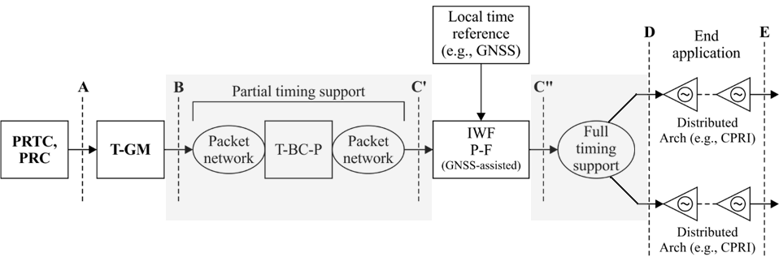
Multiple Segment Architectures
Example of multiple segment architecture:
First synchronization network segment
(Backhaul network: uses APTS method)
Second synchronization network segment
(Fronthaul network: uses FTS method)

Slide 20
Coherent Network PRTC
Network of PRTCs for improved resiliency and accuracy
PRTCs exchange time information directly, enabling both ensembling and redundancy
“Rogue” PRTCs can be detected and eliminated from timing network
Interconnect might be PTP, high accuracy PTP (e.g. White Rabbit), or dedicated optical interconnect
Possible connection to national lab for both highly accurate UTC(k) and legal time
Information on cnPRTC to go into G.8275 (Architecture) document
Status:
Expected completion by late 2020

Slide 21
Sync OAM and Management
Model proposed using an alternative PTP flow as a reference
Not a perfect reference, but a sanity check and indication of network-related issues
Described in G.SuppSyncOAM, a working document collecting Sync OAM material
Status: consented February 2020
Frequency sync defects and parameters to be documented in a revised version of G.781
Status: Published August 2017
Update consented February 2020
Time sync defects and parameters to be documented in new recommendation G.781.1
Status: probable completion late 2020

Slide 22
Tim Frost,
Strategic Technology Manager,
tim.frost@calnexsol.com

